Slide 1
Module 1
Chapter 4
Short run Economic fluctuations

Slide 2
What is trade cycle ?
A trade cycle refers to fluctuations in economic activities specially in employment, output and income, prices, profits etc. It has been defined differently by different economists. According to Mitchell, “Business cycles are of fluctuations in the economic activities of organized communities.

Slide 3
Features of trade cycle
A business cycle is synchronic. When cyclical fluctuations start in one sector it spreads to other sectors
In a trade cycle, a period of prosperity is followed by a period of depression. Hence trade cycle is a wave like movement.
Business cycle is recurrent and rhythmic; prosperity is followed by depression and vice versa
Thee business cycle is not periodical. Some trade cycles last for three or four years, while others last for six or eight or even more years.
The impact of a trade cycle is differential. It affects different industries in different ways.

Slide 4
Phases of trade cycle
Generally, a trade cycle is composed of four phases
Depression or trough
Recovery
Prosperity and
Recession.

Slide 5
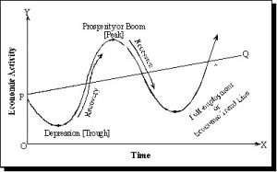

Slide 6
Boom / Peak : This phase is also known as prosperity or peak.
During this phase growth level is maximum. Income, demand, investments and profits are high. This means all the variables are at maximum
Recession: This phase comes after the phase of boom when economic activities have reached the highest level it is then followed by a slow down.

Slide 7
Depression: The phase of recession continues to the phase of depression.
There is complete slow down of all economic activities.
Consumers expect lower prices and this causes a fall in demand, production, employment.
Recovery: After the phase of depression which causes low level of economic activities, government may try to help and bring changes for the economy to function properly.
After a while demand starts to increase slowly and so does investment and employment.

